Slide 1

DATA VISUALIZATION COURSE
FACULTY OF SOCIAL SCIENCES
UNIVERSITY OF LJUBLJANA
project presentation
VISUALIZING THE SOCIAL AND ECONOMIC IMPACTS OF TOURISM ON SLOVENIAN TOWNS
JUNE 2025
01/12
NIVES HÜLL

Slide 2
01
05
INTRO
DESIGN
02
06
STORY
SOFTWARE
03
07
DATA
END PRODUCT
04
08
CHARTS
THANK YOU
JUNE 2025
02/12
NIVES HÜLL

Slide 3

intro
Tourism is often celebrated as an economic success story.
BUT WHAT HAPPENS TO LOCAL COMMUNITIES IN TOURIST TOWNS?
This project uses data visualization to explore the hidden social and economic impacts of tourism on Slovenian municipalities and towns — from housing prices to migration patterns.
JUNE 2025
03/12
NIVES HÜLL

Slide 4

story
In recent years, tourism has transformed many Slovenian towns.
At the same time, locals, especially young people, face growing challenges:
Soaring housing prices
Stagnant wages
Out-migration
Aging populations
JUNE 2025
04/12
NIVES HÜLL

Slide 5

data
Data sources:
Statistical Office of the Republic of Slovenia (SURS)
e-Prostor (real estate value data)
Data collection:
Initial goal: visualize overnight stays and accommodation capacity, but AJPES data was not easily accessible
Adjusted focus to variables that were more obtainable and relevant
Considered including commuting patterns (workplace location), but excluded to avoid overloading the visual story
Housing data was difficult to obtain; approximate values were manually extracted from e-Prostor publications
Data preparation and cleaning done in Excel; all variables combined into a long-format table
Notes:
Property price values are approximate (regional averages)
Focus: selected tourist municipalities, control cities, Ljubljana
Variables:
municipality type (tourist vs. control)
average salary
property prices
age
migration
JUNE 2025
05/12
NIVES HÜLL

Slide 6

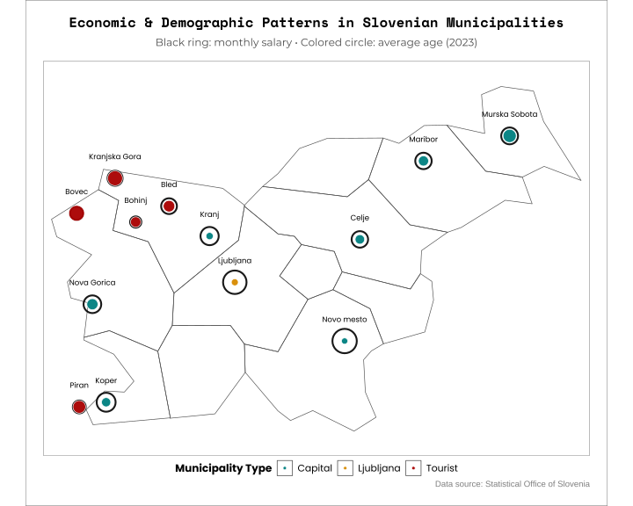
who is affected?
CHART 1: MAP WITH 4 VARIABLES (location, type, age, income)
Tourist spots show a clear pattern:
Higher average age
Lower average salaries
Demographic shifts driven by rising living costs and second-home buyers
Control cities and Ljubljana remain more balanced.
JUNE 2025
06/12
NIVES HÜLL

Slide 7

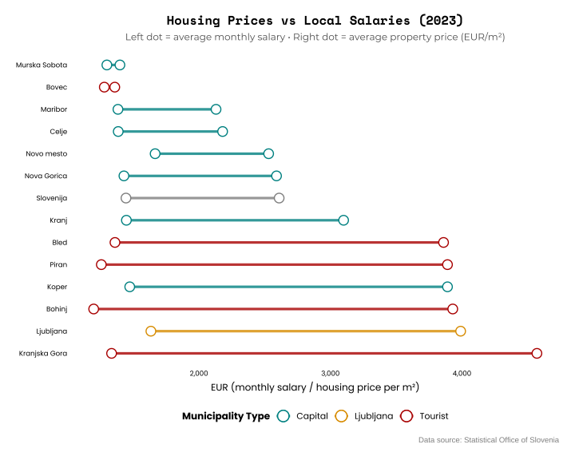
housing prices
CHART 2: DUMBBELL CHART WITH 2 VARIABLES (housing price, income)
In tourism-driven municipalities, property prices have surged far beyond local wages.
Investors and second-home buyers dominate the market.
For many young residents, home ownership is no longer realistic.
JUNE 2025
07/12
NIVES HÜLL

Slide 8

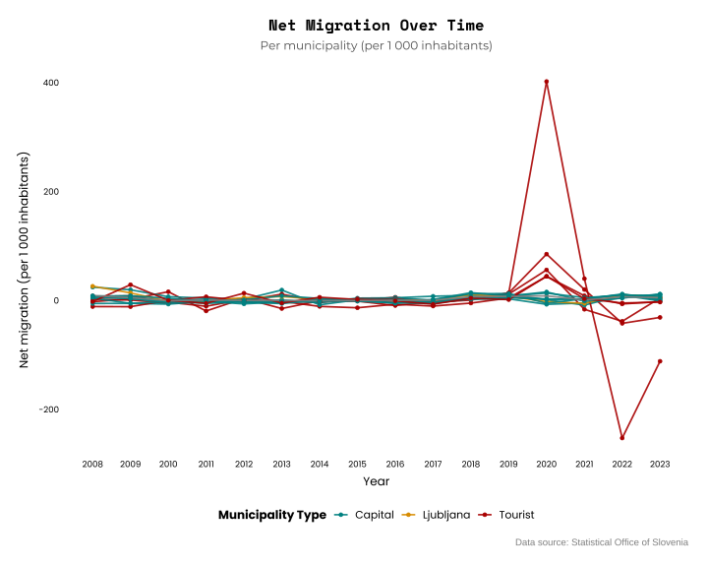
migrations
CHART 3: MULTILINE TIME SERIES CHART (net migration over time)
x-axis = years
y-axis = net migration
multiple lines = municipalities
The COVID-19 pandemic triggered a sharp shift in migration.
Tourist towns saw a spike in newcomers — often wealthier lifestyle migrants.
Meanwhile, many local families and young people are moving out.
JUNE 2025
08/12
NIVES HÜLL

Slide 9
design
Color palette:
#F0F0F0
#008080
#D78B00
#A80000
#000000
Fonts:
Montserrat
Poppins
for readability
Space Mono
for accent titles
Design goal: clean, clear, data-first storytelling.
Bright and contrast color scheme, appropriate for magazines and social media.
JUNE 2025
09/12
NIVES HÜLL

Slide 10

software
Tools used:
Excel → initial data preparation
R (tidyverse, ggplot2) → data processing and charts
Canva → infographic design and presentation
ChatGPT → code assistance
Code and all details available on GitHub.
JUNE 2025
10/12
NIVES HÜLL

Slide 11

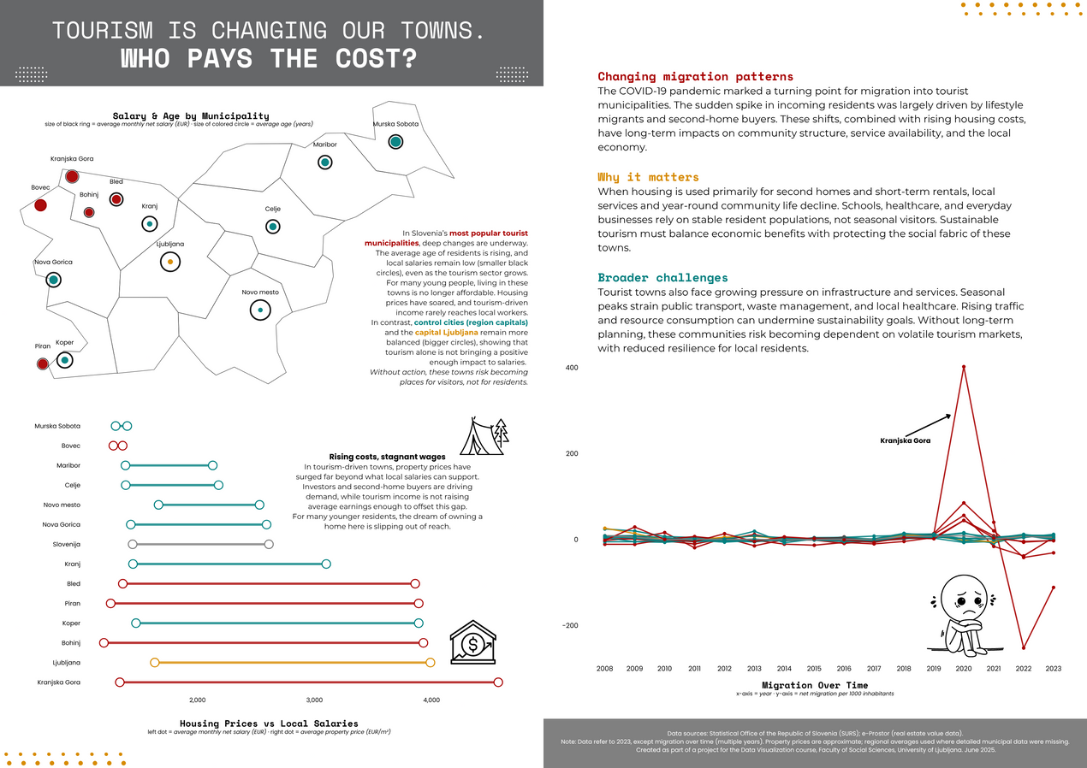
end product
Infographic combines visual data and textual explanation:
Left side introduces key variables and findings through maps and charts, accompanied by short explanatory texts.
Right side leaves open visual space around the migration chart. It invites the reader to pause and reflect on broader implications, beyond what is directly shown in the data.
The goal was to present facts and to spark critical thinking about the long-term sustainability of tourism-driven development.
Challenges and dilemmas:
Selecting appropriate chart types for each variable and story element
map with 4 variables: too complex?
Using absolute vs. relative numbers → show differences, gap
Placing charts visually to support a clear narrative flow
(Idea considered: circular structure, to show interdependence between variables, harder to visualize effectively.)
Chart titles placement not optimal?
Initial charts lacked titles → feedback: not intuitive enough → added titles
Not really satisfied with white background, maybe should add dark-mode option or consider different color scheme for bright colors
JUNE 2025
11/12
NIVES HÜLL

Slide 12

thank you
THANK YOU FOR YOUR ATTENTION.
QUESTIONS?
JUNE 2025
12/12
NIVES HÜLL

